Slide 1

B.Tech Computer Science and Engineering | BCSE497J – Project-I (Review 3)
FraudGuard AI: An Explainable Financial Fraud Detection System Using Machine Learning and Deep Learning
With Secure RESTful API and Real-Time Kafka Streaming Ingestion
Project Team Members (SCOPE):
23BCE0374 Dhruv Singh | 23BCE0415 Animesh B. Labh | 23BDS0091 Kushagra Dhelia
Project Supervisor / Faculty Guide:
Dr. Erapaneni Gayatri, Assistant Professor Sr. Grade 1
School of Computer Science and Engineering (SCOPE), VIT Vellore

Slide 2

Approval Mail From Guide
Faculty Supervisor Verification
Project Guide:
Dr. Erapaneni Gayatri
Assistant Professor Sr. Grade 1
School of Computer Science and Engineering (SCOPE)
Vellore Institute of Technology, Vellore
Review 3 Scope & Approval Confirmation:
• The official supervisor approval email for BCSE497J Project-I Review 3 is attached on the right.
• Verified academic deliverables include the Review 3 presentation deck, comprehensive 41-page project report, and working prototype codebase.
• Detailed project outcomes and automated test verification are documented on Slide 13.

Slide 3
Aim of the Project
1. Multi-Model Comparative Benchmarking
Formulate, train, and empirically benchmark four diverse fraud detection architectures:
• Supervised tree ensembles: Random Forest and XGBoost.
• Deep neural representations: Deep Neural Network (MLP) and Deep Bottleneck Autoencoder.
Compare individual discrimination performance across Precision, Recall, F1-Score, PR-AUC, and ROC-AUC on identical holdout partitions.
2. Leakage-Free Imbalance Handling
Address extreme class imbalance on the benchmark dataset:
• Actual Benchmark Prevalence: 225/15,000 = 1.5% fraud rate across 15,000 synthetic records.
Prevent methodological data leakage by restricting SMOTE-NC oversampling and RobustScaler interquartile scaling strictly to training partitions, ensuring validation and testing holdouts remain uncorrupted.
3. Explainable Predictions & Analyst Review
Embed explainable AI capabilities to assist human fraud analysts during investigation:
• Local TreeSHAP waterfall feature attributions identifying exact risk drivers.
• Quantitative balance discrepancy forensics (deltaOrig, deltaDest).
Support human-in-the-loop review through an interactive dashboard with multi-model comparison and persistent audit history.

Slide 4
Abstract
Problem Context, Dataset & Methodology
• Industrial Challenge: Digital payment expansion requires resilient fraud detection. Traditional rule engines suffer from rigidity and false alarm fatigue, while black-box models lack interpretability for human analysts.
• Benchmark Dataset: Evaluated on 15,000 locally generated synthetic transactions containing 225 fraud cases (1.50% fraud prevalence) across 9 mobile transaction fields.
• Leakage-Free Preprocessing: Stratified 60/20/20 train/validation/test split. Quantile RobustScaler fitting and SMOTE-NC minority synthesis are restricted strictly to training partitions; domain balance forensics (deltaOrig, deltaDest, R_deplete) are computed per transaction.
• Multi-Model Architecture: Benchmarks 4 diverse paradigms: Random Forest, XGBoost, Deep Neural Network (MLP), and Deep Bottleneck Autoencoder.
Implemented Prototype, Workflow & Experiments
• Implemented Academic Prototype: Containerized FastAPI REST service, interactive Streamlit workspace, and event-driven Apache Kafka streaming consumer with transactional SQLite outbox recovery.
• Primary Holdout Evaluation (3,000 txns, 45 frauds): Individual models achieve strong holdout discrimination: Random Forest (Recall: 0.9333, TP: 42), DNN (Precision: 1.0000, FP: 0), Autoencoder (F1: 0.9425, FP: 1), and XGBoost baseline (F1: 0.8889).
• Dashboard Workflow: Evaluates transactions against individual thresholds; an any-model review rule flags transactions if any detector triggers, supported by TreeSHAP local attributions and SQLite audit persistence.
• Offline Weighted-Fusion Experiment: In a separate offline experiment, a validation-tuned weighted ensemble reduced false positives from 9 to 4 compared with Random Forest, while true positives moved from 42 to 40.

Slide 5


Literature Review
Authors & Year | Model Architectures | Imbalance Method | Explainability | Deployment | Key Limitations / Research Gaps
Dal Pozzolo et al. (2018) [1] | Random Forest, LogReg, SVM | Undersampling + Calibration | None | Batch Evaluation | No neural representation learning; lacks feature-level local explainability.
Pumsirirat & Yan (2018) [4] | Autoencoder, RBM | Normal-only Unsupervised | None | Offline Prototype | Focuses on uncalibrated reconstruction distance; lacks comparative supervised baseline.
Shanaa & Abdallah (2025) [14] | Supervised Tree Models | Resampling Techniques | Feature Importance | Experimental Scripts | Evaluated on static datasets; lacks real-time ingestion and end-to-end web deployment.
Iqbal et al. (2025) [15] | Random Forest, XGBoost | Standard SMOTE | SHAP and LIME | Jupyter Notebook | Supervised-only; lacks unsupervised anomaly detection and fault-tolerant streaming architecture.
FraudGuard AI (This Work) | RF, XGBoost, DNN, Autoencoder | SMOTE-NC (Train Only) | TreeSHAP + Forensics | Implemented Prototype | Four-model comparison, threshold calibration, Kafka streaming with outbox recovery, 104 passing tests.

Slide 6
Research Gap
Gap 1: Anomaly Score Normalization and Threshold Selection in Autoencoders
• Existing Limitation: Prior hybrid detection frameworks frequently use raw, unstandardized reconstruction errors (MSE) directly alongside classifier probabilities using ad-hoc heuristics without systematic validation.
• FraudGuard AI Solution: Normalizes reconstruction error into an anomaly score and selects its threshold on validation data (tau*) to maximize F1, establishing a disciplined operational boundary before multi-model comparison.
Gap 2: Methodological Data Leakage in Preprocessing Pipelines
• Existing Limitation: Preprocessing transformations (scaling, imputation, oversampling) are frequently fit across entire datasets prior to train/test partitioning, leading to overly optimistic benchmark metrics.
• FraudGuard AI Solution: Enforces strict parameter freezing on the 60% training partition only; the 20% validation and 20% test partitions remain untouched to reflect true unseen distributions.
Gap 3: Absence of Streaming Fault Tolerance in Academic Prototypes
• Existing Limitation: Academic fraud detection prototypes typically operate as offline scripts without crash resilience, risking dropped transactions during stream interruptions.
• FraudGuard AI Solution: Implements an Apache Kafka consumer with transactional SQLite outbox persistence (pending_alerts), manual offset commits, and synchronous broker acknowledgements to enable retry and replay upon worker crashes.

Slide 7


Project Objectives & Sustainable Development Goals
Measurable Technical Objectives
1. Implement a leakage-free feature engineering pipeline, generating domain balance forensics (deltaOrig, deltaDest) and restricting SMOTE-NC strictly to training partitions.
2. Train, optimize, and benchmark four diverse model architectures: Random Forest, XGBoost, Deep Neural Network (MLP), and Deep Bottleneck Autoencoder.
3. Implement an interactive analyst dashboard supporting batch CSV ingestion, four-model comparison, and an any-model review rule with four operational risk tiers (LOW, MEDIUM, HIGH, CRITICAL).
4. Integrate explainable AI capabilities, embedding local TreeSHAP attributions and domain-specific balance forensics within an automated audit workflow.
5. Construct a containerized FastAPI RESTful microservice and SQLite workspace store featuring salted PBKDF2-HMAC-SHA256 password hashing, API-key authentication, and thread-safe WAL mode.
6. Construct an event-driven Apache Kafka real-time streaming pipeline featuring transactional outbox persistence, manual offset commits, and synchronous broker acknowledgements for crash recovery.
7. Validate system robustness through a 104-test automated regression suite achieving a 100% pass rate across all functional, security, and streaming modules.
Identified SDGs (Potential Relevance)
• SDG 8 (Decent Work & Economic Growth): Target 8.10 – Potential relevance to strengthening digital payment resilience and protecting financial transaction integrity against fraud.
• SDG 9 (Industry, Innovation & Infrastructure): Target 9.5 – Potential relevance to upgrading technological capabilities and fostering robust, explainable automated infrastructure.
• SDG 16 (Peace, Justice & Strong Institutions): Target 16.5 – Potential relevance to supporting compliance auditing and mitigating illicit financial flows and financial malpractices.

Slide 8
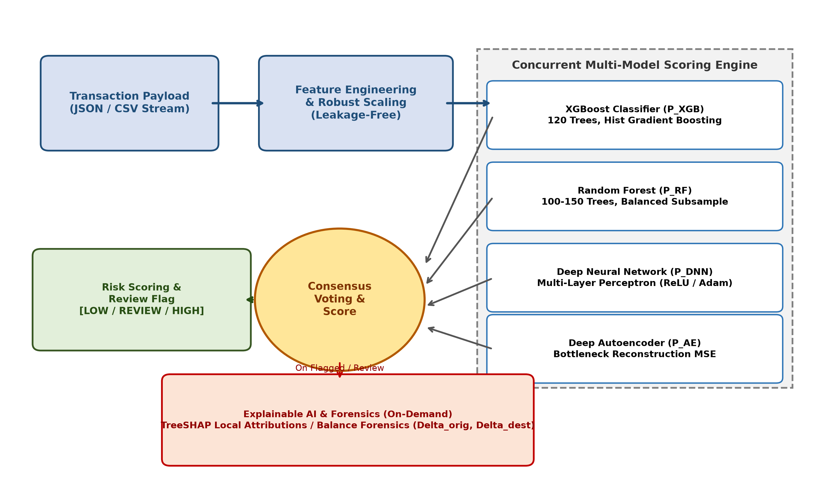
System Architecture & Execution Paths
Three Distinct Execution Paths
1. Offline Training Pipeline:
• Stratified 60/20/20 train/validation/test partitioning.
• Training-only parameter estimation (RobustScaler & SMOTE-NC).
• Independent model training and validation threshold tuning (tau*).
2. Dashboard Inference & Review:
• Streamlit analyst workspace loads trained models.
• Evaluates transactions against thresholds via any-model review rule.
• Displays local TreeSHAP waterfall feature attributions.
• SQLite workspace persistence store (WAL mode) saves user accounts, uploaded datasets, and review dispositions.
3. API & Real-Time Streaming:
• FastAPI REST gateway returns primary model prediction with comparison breakdown and vote fraction.
• Apache Kafka consumer with transactional SQLite outbox and manual offset commits for crash recovery.

Slide 9
Functional Requirements & System Specifications
Implemented Functional Requirements
• FR-1: Real-Time JSON Ingestion & Streaming: Ingest transaction payloads via synchronous FastAPI REST endpoints (/predict) or event-driven Apache Kafka topics (financial.transactions).
• FR-2: Four-Model Scoring & Risk Bands: Concurrently evaluate records across 4 models; triage individual predictions into four operational score bands: LOW, MEDIUM, HIGH, and CRITICAL.
• FR-3: Any-Model Review Rule: Flag transactions for human review whenever any individual model score meets or exceeds its calibrated threshold tau*.
• FR-4: Explainable Decision Auditing: Generate local TreeSHAP feature attribution charts and quantitative balance discrepancy indicators (deltaOrig, deltaDest) for flagged records.
• FR-5: Batch Processing & Export: Ingest and score multi-thousand row CSV datasets with persistent history, review status tracking, and filtered CSV export.
Security, Reliability & Quality Controls
• NFR-1: Local Cryptographic Hashing: Salted PBKDF2-HMAC-SHA256 (600,000 iterations) for secure local user credential storage in SQLite.
• NFR-2: Strict Deployment Secrets: Zero-fallback environment secret enforcement via ${FRAUDGUARD_API_KEY:?Set FRAUDGUARD_API_KEY} in Docker Compose.
• NFR-3: Transactional Outbox & Crash Recovery: Persistent SQLite pending_alerts table with manual Kafka offset commits enabling message replay and retry upon consumer crash.
• NFR-4: Thread-Safe Persistence: SQLite WAL mode supporting concurrent analyst read/write sessions without database locking.
• NFR-5: Responsive Interaction: Direct model tensor invocation delivering responsive sub-second interactive scoring across dashboard workflows and streaming feeds.

Slide 10
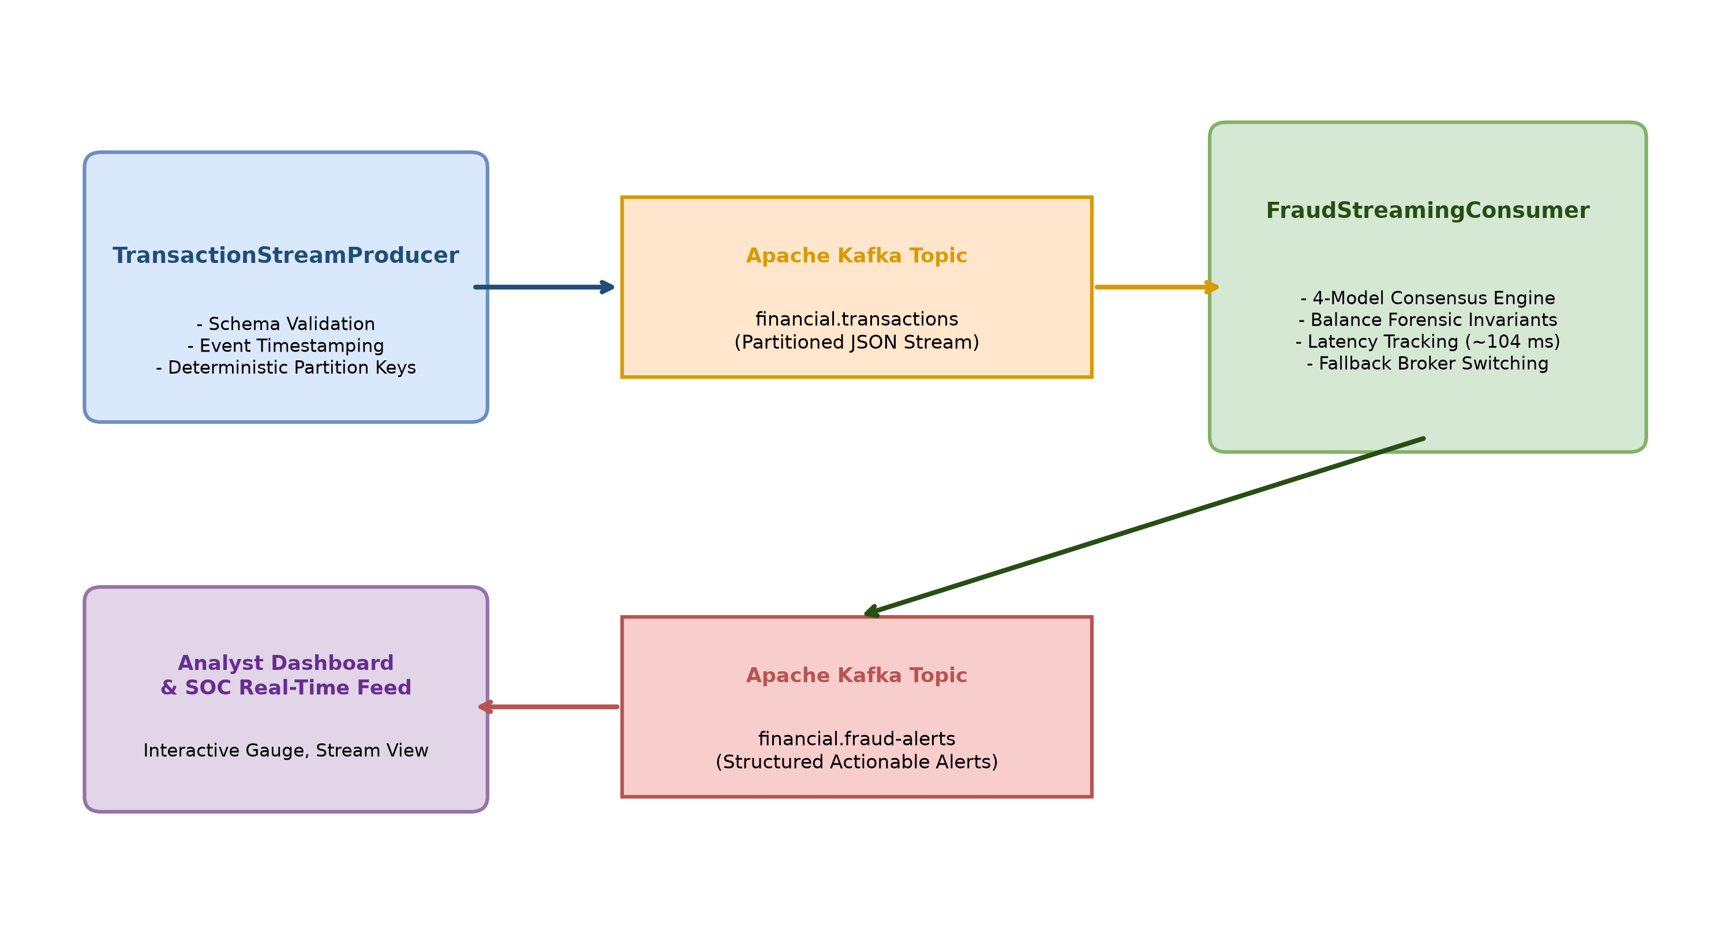
Software Modules & Implementation
Implemented System Modules (Repository)
• Module 1: Preprocessor & Feature Forensics (src/preprocessor.py): Quantile RobustScaler fitting, median imputation, discrepancy features: deltaOrig = newOrig + amount - oldOrig, deltaDest = oldDest + amount - newDest.
• Module 2: Model Comparison & Evaluation (src/model_comparison.py): Evaluates four diverse models across holdout partitions; calculates precision, recall, F1, PR-AUC, and ROC-AUC.
• Module 3: Explainability Pipeline (src/explainability.py): TreeSHAP local attributions, feature importance waterfall generation, and directional explanation factors. (Note: src/transaction_explanation.py does not exist in checked repository).
• Module 4: RESTful API Gateway (src/api.py): FastAPI endpoints (/predict, /health, /metrics), API-key authentication, rate-limiting, and primary model prediction with comparison breakdowns.
• Module 5: Fault-Tolerant Streaming (src/kafka_streaming.py): Kafka consumer/producer, transactional outbox (pending_alerts), synchronous broker ACK, and manual offset commits.
• Module 6: Workspace Persistence Store (src/workspace_store.py): Thread-safe SQLite store managing user accounts, uploaded datasets, prediction history, and case review escalation.

Slide 11
Experimental Evaluation & Performance Results
Model Architecture | Accuracy | Precision | Recall | F1-Score | ROC-AUC | PR-AUC | TP | FP | FN
Random Forest | 99.60% | 0.8235 | 0.9333 | 0.8750 | 0.9989 | 0.9581 | 42 | 9 | 3
XGBoost | 99.67% | 0.8889 | 0.8889 | 0.8889 | 0.9968 | 0.9418 | 40 | 5 | 5
Deep Neural Network | 99.83% | 1.0000 | 0.8889 | 0.9412 | 0.9863 | 0.9307 | 40 | 0 | 5
Deep Autoencoder | 99.83% | 0.9762 | 0.9111 | 0.9425 | 0.9909 | 0.9586 | 41 | 1 | 4
Key Model Strengths & Individual Trade-Offs
• Random Forest: Highest recall (0.9333, 42 TP) among the four individual models, identifying the maximum number of fraud incidents.
• Deep Neural Network: Zero false positives (0 FP, 1.0000 precision) on this particular holdout, eliminating false alarms on legitimate transactions.
• Deep Autoencoder: Highest individual-model F1 score (0.9425) on this holdout, balancing high recall (0.9111) with only 1 false positive.
• XGBoost: Validation-selected benchmark baseline; selected based on validation set performance, confirming stability on holdout testing.
Methodological Scope & Results Citation
• Evaluation Holdout: 3,000 untouched holdout transactions (60/20/20 split; 225 total frauds = 1.50% prevalence).
• Threshold Selection: Each model is evaluated independently against its own validation-tuned operating threshold (tau*).
• Saved Result Files: Verified directly from results/model_results.csv and results/holdout_evaluation_report.json.
• Note: Offline weighted fusion, distribution shift, and cost simulations are detailed on dedicated backup slides.

Slide 12
Conclusion & Future Work
Conclusions & Operational Insights
• Multi-Model Trade-Offs: Supervised tree ensembles offer superior recall and native SHAP interpretability; deep neural architectures achieve zero or near-zero false alarms and unsupervised anomaly detection; no single model dominates across all operating criteria.
• Synthetic Benchmark Limitations: Evaluated on 15,000 locally generated synthetic transactions. While matching mobile payment schemas, synthetic distributions do not reflect live adversarial fraud evolution; continuous telemetry is required.
• Explainability Scope: TreeSHAP local attributions and ledger forensics provide critical decision transparency for human analysts, though technical explainability alone does not constitute statutory legal compliance.
• Implemented Streaming Reliability: Transactional SQLite outbox (pending_alerts), manual offset commits, and synchronous broker acknowledgements provide verified message resilience across tested crash and disconnect scenarios.
Future Research Roadmap
• Graph Neural Networks (GNNs): Incorporate Relational Graph Convolutional Networks (R-GCNs) to detect money mule rings, collusion subgraphs, and synthetic identity fraud networks.
• Online Concept Drift Adaptation: Integrate streaming drift detectors (ADWIN, DDM) to trigger automated pipeline recalibration under evolving payment distributions.
• Pre-Authorization Telemetry: Expand beyond retrospective ledger balance features by incorporating real-time behavioral velocity and device fingerprinting.
• Model Quantization: Deploy ONNX Runtime and TensorRT quantization for ultra-low latency edge inference.

Slide 13
Outcomes Achieved
Tangible Project Outcomes & Verified Deliverables
1. Working Academic Prototype & Microservice:
• Multi-container Docker Compose architecture defining API, dashboard, Kafka, and ZooKeeper services with strict deployment secret enforcement (${FRAUDGUARD_API_KEY}).
• Modular Python software combining FastAPI REST endpoints, Streamlit analyst workspace, and Kafka real-time streaming ingestion.
2. Comprehensive Automated Regression Verification:
• 104 automated tests achieving a 100% PASS rate across 9 test suites covering preprocessing, model scoring, explainability, API security, streaming recovery, and SQLite persistence.
• Explicitly attributed to the saved test report in results/test_report.txt and results/test_summary.json.
3. Open-Source Codebase & Reproducible Artifacts:
• Public GitHub Repository: https://github.com/animeshlabh57-rgb/AI-Based-Financial-Fraud-Detection-System
• Contains complete modular source code, trained model weights, evaluation benchmark scripts, and Docker orchestrations.
4. Academic Documentation & Publication Trajectory:
• Comprehensive 41-page B.Tech Project-I Academic Project Report (BCSE497J) formatted in accordance with VIT IEEE guidelines.
• Future Publication Trajectory: Target preparation for submission to a peer-reviewed Scopus-indexed conference / journal (kept separate from achieved outcomes).

Slide 14
References
[1] A. Dal Pozzolo, G. Boracchi, O. Caelen, et al., 'Credit card fraud detection: A realistic modeling and a novel learning strategy,' IEEE Trans. Neural Netw. Learn. Syst., vol. 29, no. 8, pp. 3784–3797, Aug. 2018.
[2] A. Dal Pozzolo, O. Caelen, R. A. Johnson, and G. Bontempi, 'Calibrating probability with undersampling for unbalanced classification,' in Proc. IEEE SSCI, 2015, pp. 159–166.
[3] N. V. Chawla, K. W. Bowyer, L. O. Hall, and W. P. Kegelmeyer, 'SMOTE: Synthetic minority over-sampling technique,' J. Artif. Intell. Res., vol. 16, pp. 321–357, 2002.
[4] A. Pumsirirat and L. Yan, 'Credit card fraud detection using deep learning based on auto-encoder and restricted Boltzmann machine,' Int. J. Adv. Comput. Sci. Appl., vol. 9, no. 1, pp. 18–25, 2018.
[5] L. Breiman, 'Random forests,' Mach. Learn., vol. 45, no. 1, pp. 5–32, 2001.
[6] T. Chen and C. Guestrin, 'XGBoost: A scalable tree boosting system,' in Proc. 22nd ACM SIGKDD, 2016, pp. 785–794.
[7] J. An and S. Cho, 'Variational autoencoder based anomaly detection using reconstruction probability,' Special Lecture on IE, vol. 2, no. 1, pp. 1–18, 2015.
[8] S. M. Lundberg et al., 'From local explanations to global understanding with explainable AI for trees,' Nature Mach. Intell., vol. 2, no. 1, pp. 56–67, 2020.
[14] M. Shanaa and S. Abdallah, 'A hybrid anomaly detection framework combining supervised and unsupervised learning for credit card fraud detection,' F1000Research, vol. 14, art. 664, 2025.
[15] S. Iqbal, K. M. Awan, S. Kamal, and Z. Ur Rehman, 'Interpretable ensemble learning models for credit card fraud detection,' Appl. Sci., vol. 15, no. 22, art. 12073, 2025.
Repository & Saved Experimental Evidence:
• GitHub Codebase: https://github.com/animeshlabh57-rgb/AI-Based-Financial-Fraud-Detection-System
• Primary Results: results/model_results.csv | Secondary Shift: results/independent_benchmark_report.json | Tests: results/test_report.txt

Slide 15
Dataset Provenance & Experimental Methodology
Benchmark Dataset & Preprocessing Pipeline
• Dataset Source: 15,000 locally generated synthetic transactions mimicking mobile money transfer semantics (not an official PaySim release or real banking data).
• Fraud Prevalence: Exactly 225 fraud cases out of 15,000 transactions (1.50% prevalence; 225/15,000).
• Input Schema: 9 attributes including transaction step, transfer type (TRANSFER, CASH_OUT, PAYMENT, DEBIT, CASH_IN), amount, and balances.
• Domain Balance Forensics:
- Origin balance discrepancy: deltaOrig = newbalanceOrig + amount - oldbalanceOrg
- Destination balance discrepancy: deltaDest = oldbalanceDest + amount - newbalanceDest
- Depletion indicator (origDepleted: sender account fully emptied) and destination surge factor.
Experimental Partitions & Leakage Prevention
• Strict Stratified Partitions (60 / 20 / 20 Split):
- Training Set (60%): 9,000 transactions (135 fraud, 8,865 legitimate).
- Validation Set (20%): 3,000 transactions (45 fraud, 2,955 legitimate).
- Holdout Test Set (20%): 3,000 transactions (45 fraud, 2,955 legitimate).
• Leakage-Free Isolation:
- Quantile RobustScaler parameters and median imputers are fit strictly on the 60% training set.
- SMOTE-NC synthetic oversampling is restricted strictly to the training partition.
- Validation and test sets remain completely untouched during all data engineering.
• Validation-Based Threshold Selection: Model operating thresholds tau* are selected on the validation partition to optimize F1-score; final metrics are evaluated once on untouched holdout test data.

Slide 16
Additional Offline Weighted-Fusion & Cost Analysis Experiment
Offline Weighted-Fusion Formulation & Results
• Distinct Experimental Scope: This is an additional offline research experiment evaluated on the 3,000-transaction holdout, distinct from the dashboard's individual-model review rule.
• Fusion Formulation: Combines normalized model scores using fixed empirical weights:
S_fusion(x) = 0.25*S_RF + 0.35*S_XGB + 0.20*S_DNN + 0.20*S_AE
Evaluated against validation-selected composite threshold tau* = 0.7916.
• Performance Trade-Off:
'In the offline weighted-fusion experiment, false positives decreased from 9 to 4 compared with Random Forest (a 55.6% reduction), while true positives decreased from 42 to 40.'
• Holdout Test Metrics: Precision: 0.9091 | Recall: 0.8889 | F1-Score: 0.8989 | ROC-AUC: 0.9985 | PR-AUC: 0.9555.
Financial Cost-Benefit Scenario Modeling
• Asymmetric Cost Framework:
- Missed Fraud Cost (C_FN) = $2,500 (direct financial loss + chargeback penalty).
- False Alarm Investigation Cost (C_FP) = $35 (compliance analyst triage overhead).
- True Positive Triage Cost (C_TP) = $10 (verification workflow cost).
• Loss Comparison Across Scenarios:
- Baseline Loss (Unmonitored System): $112,500 across 45 fraud incidents (45 * $2,500).
- Weighted-Fusion Operational Loss: $13,040 ($12,500 FN + $140 FP + $400 TP).
• Simulated Financial Outcome: '88.4% simulated loss reduction under assumed costs' (+$99,460 simulated savings; scenario calculation, not measured bank savings).

Slide 17
Cross-Generator Distribution Shift & Robustness
Model Architecture | Test Recall | True Positives (TP) | False Positives (FP) | False Negatives (FN) | Operational Behavior
Random Forest | 0.00% (0/15) | 0 | 0 | 15 | Total Recall Collapse
XGBoost | 0.00% (0/15) | 0 | 0 | 15 | Total Recall Collapse
Deep Neural Network | 100.0% (15/15) | 15 | 87 | 0 | 100% Recall, Elevated FPs
Deep Autoencoder | 100.0% (15/15) | 15 | 336 | 0 | 100% Recall, Very High FPs
Critical Robustness Findings (1,000 txns, 15 frauds)
• Tree Recall Collapse: Tree ensembles (Random Forest, XGBoost) suffered complete recall failure (0/15 caught) when evaluated against an independently generated synthetic dataset due to orthogonal decision boundary shifts.
• Elevated False Positives in Deep Models: While deep models caught 100% of frauds (15/15), the Deep Neural Network produced 87 false positives and the Autoencoder produced 336 false positives.
• Honest Generalization Lesson: Reporting 100% recall alone without reporting false positives would be misleading; high false alarm rates create severe analyst fatigue.
Academic Defense & Real-World Implications
• Synthetic Data Limitation: Offline synthetic benchmarks do not guarantee real-world generalization; distributional covariance shifts easily evade static tree thresholds.
• Operational Requirement: Automated models must operate in an advisory human-in-the-loop triage capacity rather than an autonomous decision authority.
• Pipeline Recommendation: Continuous concept drift monitoring (ADWIN) and adaptive retraining are essential before deploying to live financial environments.
• Saved Evidence: results/independent_benchmark_report.json.

Slide 18
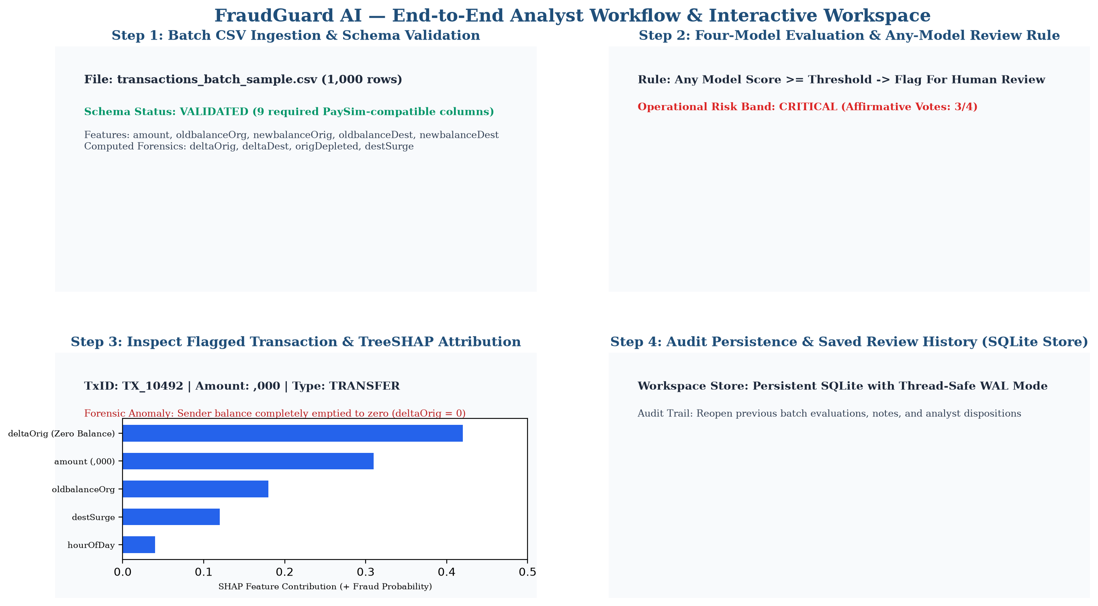
Streamlit System Workflow & User Interface Demonstration
End-to-End Analyst Workflow Implemented in Streamlit Workspace:
(1) Batch CSV upload & schema validation -> (2) Four-model evaluation under any-model review rule (LOW/MED/HIGH/CRITICAL) -> (3) Flagged transaction inspection with local TreeSHAP waterfall attributions -> (4) Audit persistence in thread-safe SQLite workspace store.

